Slide 1

1.08.24
IT Career Hub Internship for MiGriS - TU Berlin
Data Analysis for Hamburg, Dugopolje, Antalya

Slide 2
Antalya
Turkey

Slide 3
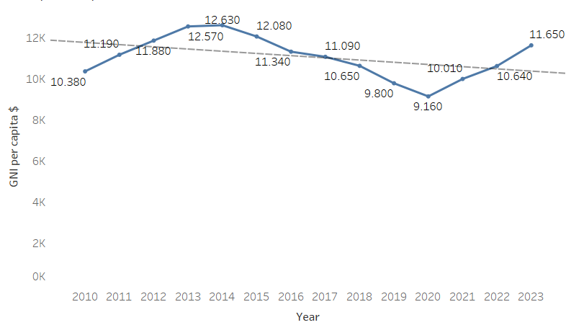
GNI per capita
GNI per capita ($) is for Turkey.
It is unstable.
Antalya | Tableau Public
Notes:
On this slide, we can see the Gross National income per capita (in US dollars) for the entire Turkey in the period from 2010 to 2023 by years.
In 2010 the GNI was a little higher than 10 300, compared to 2023 which is 11 600, for this period in 13 years it’s increased but not much.
As we can see GNI per capita is unstable, it's gowing and then falling down. Some analytics said that from 2014 the investment money went back to the USA. Now GNI per capita in Turkey is growing, but not too much. Also in 2020 was the lowest amount of GNI it’s also reasonable during COVID-19 shutdown many economics especially in tourists countries went down.
The trend line or dotted line shows decreasing values.

Slide 4
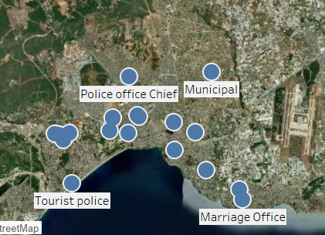
Government agencies
Most of the Government agencies are located near the coast
Antalya | Tableau Public
Notes:
This slide shows the location of the government agencies. It is a map of Antalya and the blue dots it is a places of government agencies like a Tax department, City Administration, Migration office, Municipal office, Police stations, and Marriage office.
I heard you have an idea to set up government couriers with bikes instead of cars. So it is a good idea. Most government agencies are located close to each other and close to the cost.

Slide 5
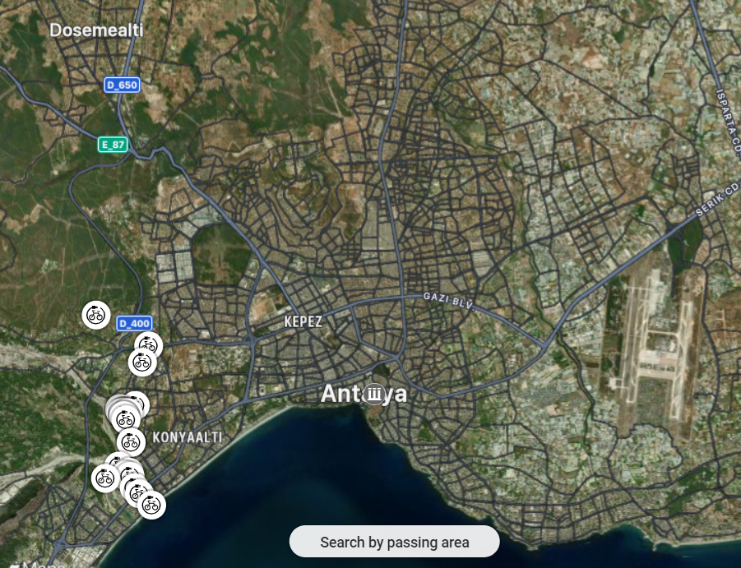
E-bike routes
All e-bike routes are located on the east of Antalya
Antalya | Tableau Public
Notes:
This map shows us the most popular private tourist routes in Antalya. I found these routes on the website where the tourists and local citizens can share their routes or routes they liked with the community. On the website, there are a lot of routes for different kinds of bikes. For other types of bikes, you can find routes all around the city, but as you can see e-bike routes are only in the east of Antalya. To be honest I don't know what is the reason. Maybe not many people has e-bikes and only those who lives in the east. So they can not go far without opportunity to charge their bike.
One of the reasons can be the fact, that Antalya does not have battery charging stations.
Why am I talking about private routes? Because in Antalya you can also find a tourist tour around the city on e-bikes. The duration is approximately half of the day, and the price starts from 50 EURO. Also, it can be a good partnership with this excursion agency. The link to their website you can find in the slide sources.

Slide 6
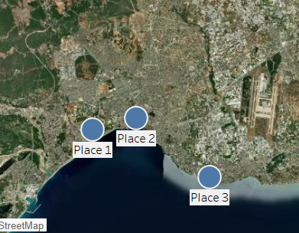
Ideas
Possible places to set up station
Antalya | Tableau Public
Notes:
Here we can see ideas to set stations in Antalya. I also checked the bike-sharing stations, there are some, but it’s not like we used to see in Germany. I mean bikes lying on the street. It is like shops with working hours where you can rent a bike for a day or a couple of days. All of them are located in the city center close to the cost.
In Antalya, at the moment you will not have a competitor. Since Antalya is a resort city, most resort cities are as crowded as near to the coast. It can be a good idea, to set up a station close to the beach area.
All provided places can be worked both ways for private users and same as for government needs.
Place 1 is close to bike community routes, place 2 is in the center of the city, and the approximate same distance to reach every side of the town, and place 3 is close to the farthest government agencies, third place is more like an idea, at the beginning better to take in consideration first two places.
The picture presents an approximate place, more like an area.

Slide 7
Sources about Antalya
https://data.worldbank.org/indicator/NY.GNP.PCAP.CD?locations=TR
https://excursionmania.com/excursions/antalya-electric-bike-tour/
https://www.macrotrends.net/global-metrics/cities/22658/antalya/population#:~:text=The%20current%20metro%20area%20population,a%202.49%25%20increase%20from%202021.
https://www.wikiloc.com/wikiloc/map.do?sw=36.83616286525452%2C30.58106233365834&ne=37.00578794704402%2C30.84473420865834&act=118&lfr=14&page=1
https://www.google.com/maps/@36.8979091,30.6357038,12z?entry=ttu
https://www.google.de/maps/search/bike+rental+Antalya/@36.9536115,30.5795313,10.5z?entry=ttu
Notes:
Here are links to all the sources that I have used.
The second link is a link to the bike excursion agency.

Slide 8
Dugopolje
Croatia

Slide 9
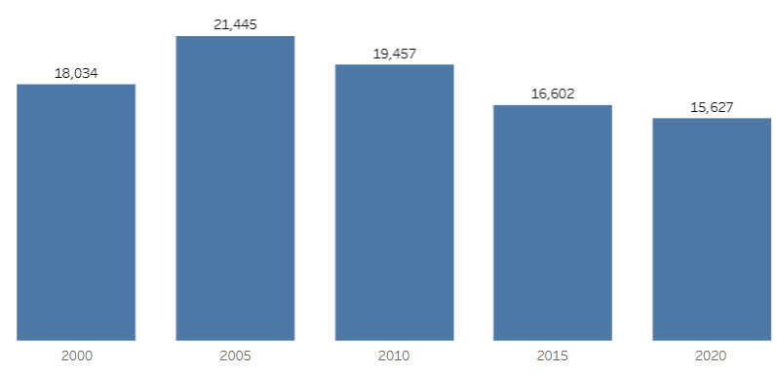
Air Pollution
Kilotons of Co2 in Croatia from 2000 to 2020
We can see dynamic graphs here:
Dugopolje | Tableau Public
Notes:
This slide presents the dynamic air pollution of CO2 in kilotones for the entire Croatia from 2000 to 2020.
As we can see the worst situation was in Croatia in 2005. After this year air pollution of CO2 in Croatia is slowly but decreasing.

Slide 10
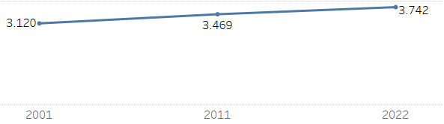
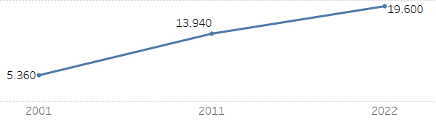
Population and GNI by years
Population for Dugopolje
GNI per capita ($) is for the entire Croatia
Notes:
In this picture, on the left side we can see the dynamic of the population of Dugopolje it is slowly but increasing.
For the past 20 years, it’s grown up to 600 people.
On the right side, we can see the dynamic, of the Cross-National income per capita in US dollars for the entire Croatia. As we can see it is grown better than the population. In 2001 the GNI was 5300 and the GNI in 2022 was 19,600. For 20 years, it increased to over 13 thousand and it’s constantly increasing.

Slide 11
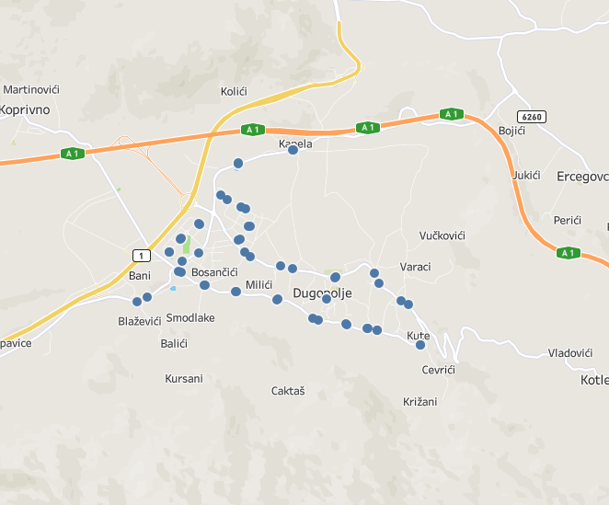
Public transportation
Bus stops located in a circle
5 buses
Waiting time is approx 1 hour
Dugopolje | Tableau Public
Notes:
This slide presents all public transportation stops in Dugopolje. The only public transport in Dugopolje is’t a bus, there is no train stations, nearest train station located in the Split.
As we can see all bus stops in Dugopolje are located in a circle around the city. Through Dugopolje are 5 different buses and all of them are intercity buses. There are no local buses. Usually, the waiting time for a bus is approximately 1 hour or more, depending on the bus stop and bus number. I assume most people in Dugopolje have their own transport like cars or bicycles.

Slide 12
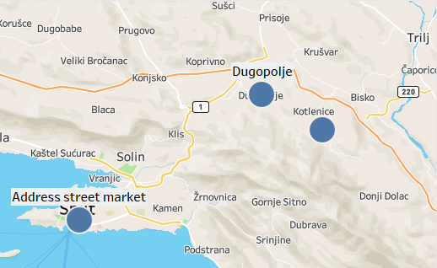
Common routes
Dugopolje
Height above the sea is about 300 m
Split
height above the sea 0 m
Vranjaca Cave
Height above the sea is about 500 m
Distance
Dugopolje - Split distance - 21 km
Dugopolje - Vranjaca Cave distance - 8 km
Dugopolje | Tableau Public
Notes:
This slide presents the most common place for local citizens, the distance to get there, and high above the sea. I believe in this case it is important.
Split is the closest big city to Dugopolje, there are located nearest Farmers Market, and farmers from Dugopolje may go there to sell their goods. It may be a good option for cargo bikes.
Vranjaca Cave is an old cave and it is the most popular excursion direction around Dugopolje.
On the way from Split to Dugopolje height above sea level increases up to 300 meters by distance in 21 kilometers.
On the way from Dugopolje to Vranjaca Cave height above sea level increases up to 200
meters by distance in 8 kilometers.
To be honest, when I create routes in Google Maps, it doesn’t allow me to choose the bicycle option and shows a notification that it’s impossible to reach the destination by bike. However, I managed to find many bicycle routes on other websites around Dugopolje and also to Split, but these routes do not go along the highway. They mostly follow small roads that are not equipped with bike paths. Therefore, tourists might be hesitant to rent bikes due to safety concerns.

Slide 13
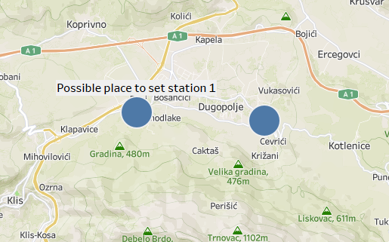
Possible place to set a station
The first possible place is located in a more crowded and passable place.
The second location is on the way to Vranjaca Cave. It is a less crowded area.
Latitude and Longitude for the stations provided approximately.
Dugopolje | Tableau Public
Notes:
This slide presented two Possible Locations for the Station
Location 1:
This location is beneficial for both local residents and travelers passing through Dugopolje from nearby small towns.
It is suitable for both regular and cargo bikes.
Positioned in Dugopolje, it is located near the city’s exit towards Split, close to the highway, but not directly on it, as bicycles are not allowed on highways.
I find this spot as best, because it captures traffic from people coming from Split and other nearby places, who might turn off before reaching the station if it were placed further down the road towards Kapela, or in the middle of the city. It also accommodates traffic going through Dugopolje from Koprivno.
Location 2:
This location caters to rented or private bikes on excursion routes heading towards the Vranjaca Cave.
While it could be an interesting spot for the station. But, most people would likely notice and access the station better at the first location.
The image illustrates an approximate area, rather than an exact spot.

Slide 14
Sources about Dugopolje
https://www.city-facts.com/dugopolje/population
https://knoema.com/atlas/Croatia/topics/Economy/National-Accounts-Gross-National-Income/GNI-per-capita-based-on-PPP
https://www.google.com/maps/dir/Dugopolje,+%D0%A5%D0%BE%D1%80%D0%B2%D0%B0%D1%82%D0%B8%D1%8F/%D0%9F%D0%B5%D1%89%D0%B5%D1%80%D0%B0+%D0%92%D1%80%D0%B0%D0%BD%D1%8C%D1%8F%D1%86%D0%B0,+Unnamed+Road,,+21204,+Kotlenice,+%D0%A5%D0%BE%D1%80%D0%B2%D0%B0%D1%82%D0%B8%D1%8F/@43.5742307,16.6050116,14z/data=!3m1!4b1!4m13!4m12!1m5!1m1!1s0x134aa6e6a7e3de0f:0x4392b4e3816d5654!2m2!1d16.5989117!2d43.582096!1m5!1m1!1s0x134aa413700c1a5d:0x4b97b699105f979d!2m2!1d16.6482314!2d43.5622166?hl=ru&entry=ttu
https://www.booking.com/searchresults.de.html?ss=Dugopolje&ssne=Dugopolje#map_opened
https://www.tripadvisor.ru/Attraction_Review-g303838-d13529975-Reviews-Green_Market-Trogir_Split_Dalmatia_County_Dalmatia.html
https://forum.awd.ru/viewtopic.php?f=1238&t=283348
https://tourist.hr/location/kotlenice
https://www.tripadvisor.com/Attractions-g295370-Activities-c26-t142-Split_Split_Dalmatia_County_Dalmatia.html
https://www.rome2rio.com/map/Split/Dugopolje#trips
https://www.citypopulation.de/en/croatia/admin/split_dalmacija/5851__dugopolje/
Notes:
Here are the links to all the sources I have used.

Slide 15
Hamburg
Germany
Notes:
I know that Hamburg is not on your list. But I find interesting to research this city as well. It’s may be helpful later on when you decide to increase your geography.

Slide 16
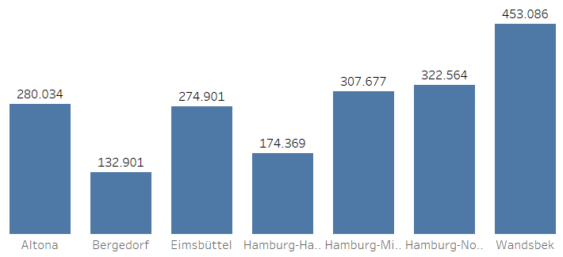
Population in Hamburg 2022
Divided by district population
We can see the dynamic graphs here:
Hamburg | Tableau Public
Notes:
In this picture, we can see the population dynamics in Hamburg in 2022, divided by districts.
Bergedorf and Hamburg-Harburg are the least populated districts, with fewer than two hundred thousand people each. These districts are located in the south of Hamburg, where there are large green areas.
Wandsbek is the most populated district, with 450,000 residents. It is situated in the northeast of Hamburg.
Altona is in the middle in terms of population, with 280,000 residents. This district is in the west of Hamburg, located along the Elbe River.

Slide 17
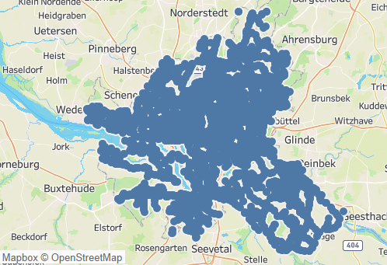
Public transportation
There are 4,422 public transport stops in Hamburg.
Hamburg | Tableau Public
Notes:
This slide presents all public transportation stops in Hamburg.
Overall, Hamburg is well-served by public transportation, with a total of 4,422 stops. The areas that are not covered are mostly green spaces.

Slide 18
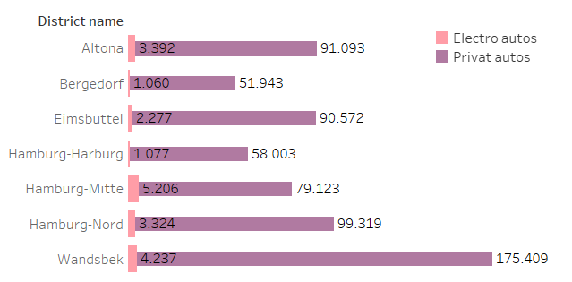
Autos vs Electro Autos in Hamburg
Information based on 2022 data
Hamburg | Tableau Public
Notes:
This slide shows the correlation between regular cars and electric cars in 2022, divided by district registrations in Hamburg.
The highest number of cars is registered in Wandsbek – 175,000 vehicles, which, as we recall, is in the northeast of Hamburg.
The largest number of electric cars is registered in the city center, Hamburg-Mitte – 5,200 vehicles.
The lowest numbers for both types of cars are registered in the districts of Bergedorf and Hamburg-Harburg, located in the south of Hamburg – 51,000 and 58,000 vehicles, respectively.
Altona falls in the middle for both categories with 91,000 vehicles.
This data is from 2022. I believe that in the past two years, the trend has shifted more in favor of electric cars, though I don’t have specific numbers to confirm this.

Slide 19
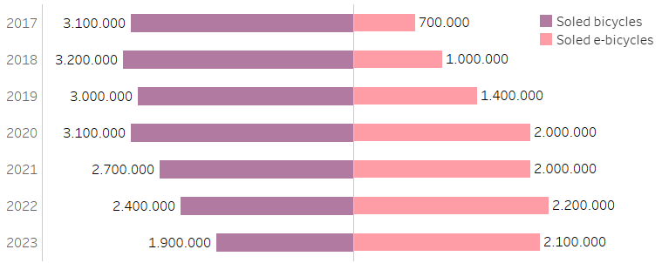
Sales of bicycles vs e-bikes in Germany
Last year sales of e-bikes were more than regular bikes
Hamburg | Tableau Public
Notes:
This slide presents the correlation between bike and e-bike sales in Germany from 2017 to 2023.
Since 2017, e-bike sales in Germany have been gradually increasing.
From 2020 onwards, sales of regular bikes have been slowly decreasing in favor of e-bikes.
Last year, e-bike sales surpassed regular bike sales by 200,000 units.
As we can see, the trend is shifting towards a preference for e-bikes.

Slide 20
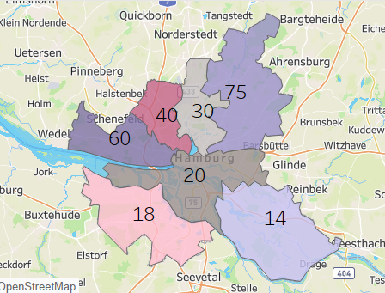
Bikes sharing stations
Amount of bike sharing stations in 2024 by districts
75 - Wandsbek
60 - Altona
Hamburg | Tableau Public
Notes:
Here we can see the number of bike-sharing stations in 2024 by district in Hamburg.
The highest number of bike-sharing stations is in Wandsbek – 75 stations (located in the northeast of Hamburg), followed by Altona with 60 stations (in the west of Hamburg).
The smallest number of bike-sharing stations is found in the districts of Bergedorf and Hamburg-Harburg (located in the south of Hamburg).

Slide 21
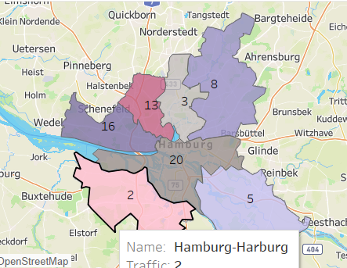
Traffic by districts
Traffic Scores in Hamburg:
Wandsbek: 8
Altona: 16
Hamburg-Mitte: 20
Hamburg | Tableau Public
Notes:
Here we can see the traffic scores in Hamburg.
The highest traffic score is in Hamburg-Mitte – 20 (city center), followed by Altona with a score of 16 (in the west of Hamburg). Wandsbek has a score of 8 (northeast of Hamburg), which is surprising given that it has the largest number of registered cars.
The lowest traffic scores are found in the districts of Bergedorf and Hamburg-Harburg – 5 and 2, respectively (located in the south of Hamburg).
It is worth noting that traffic congestion from the major highways coming from the northwest and west also affects overall traffic. Additionally, traffic might be influenced by construction work or repairs.

Slide 22
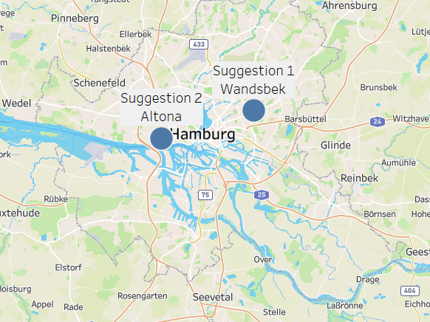
Possible place to set a station
The Wandsbek and Altona are the most promising.
The picture presented an approximate place more like an area
Hamburg | Tableau Public
Notes:
This slide presents the most promising locations for setting up the station.
The top location, based on several key metrics such as population, the number of registered cars, bike-sharing stations, and traffic, is Wandsbek, followed by Altona. Positioning the station between the city center and these two districts, but closer to the city center, would be advantageous. The city center is more crowded and has a higher number of electric vehicles, indicating a preference for e-vehicles among its residents. Additionally, parking is a common issue in the city center, which is less of a concern with e-bikes.
Suggestion 1 appears to be the most promising since Wandsbek has the largest population and area.
The picture shows an approximate area rather than an exact location.

Slide 23
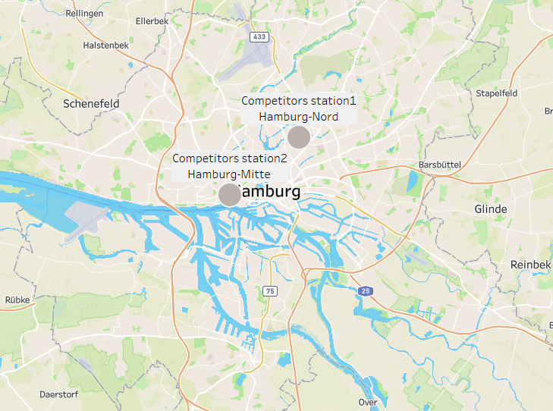
Competitors (Swobbee)
Swobbee has two stations in Hamburg.
Both of them are near to the city center.
Hamburg | Tableau Public
Notes:
I added this competitor analysis slide after Antonina provided the information.
On this slide, we can see the existing stations of your competitors. The company Swobbee has placed two stations very close to the city center: one in Hamburg-Mitte and another station at Hamburg-Nord. Although my analysis is near these competitor stations, this proximity indicates that this is a key area where you are likely to encounter potential customers. This further, supports the decision to set up a station in this location.

Slide 24
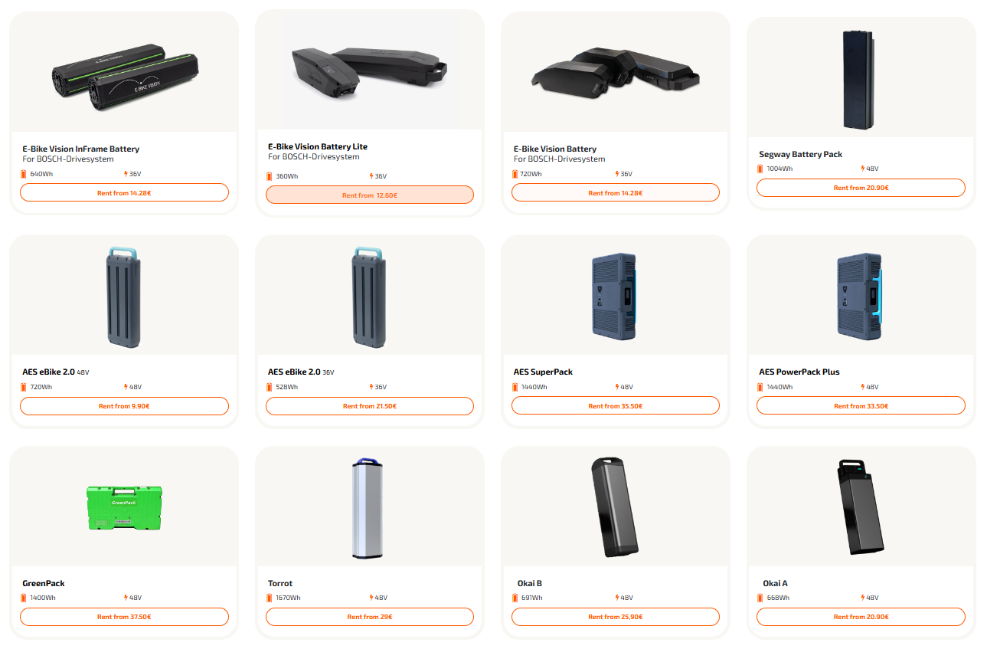
Competitors supplies
The price deviat between 10 and 40€ per months.
Notes:
Here we can see the equipment provided by the Swobbee company at their stations.
Competitors offer several types of batteries, with prices ranging from €10 to €40 per month, depending on the battery type and rental term.
You can also visit their website on your way to the station and check the available batteries at the stations. I’m not sure if you have a similar feature planned, but it seems useful and user-friendly.

Slide 25
Sources about Hamburg
https://www.statistik-nord.de/fileadmin/maps/Stadtteil_Profile_2022/atlas.html
https://justreal.ru/articles/rayony-gamburga/
https://realting.com/germany/hamburg
Swobbee Battery rental / charging infrastructure for micromobility
https://propimo.com/en/german/r/free-and-hanseatic-city-of-hamburg
https://geoln.com/property/germany/hamburg
https://ew-realestate.com/?s=Hamburg
https://geoln.com/real-estate/germany/hamburg
https://geoln.com/germany/hamburg
https://realting.com/germany/hamburg
https://estate-service24.de/catalog/zhilaya-nedvizhimost/flats-apartments/kvartiry-v-gamburge/
https://propimo.com/en/german/r/free-and-hanseatic-city-of-hamburg/f/flats
https://www.immowelt.de/immobilienpreise/hamburg/wohnungspreise
Q_II_11_j_20_HH.xlsx (live.com)
Kl. Grasbrook, Hafen, Hamburg, Germany Air Pollution: Real-time Air Quality Index (aqicn.org)
Q_V_3_j21_HH.pdf (statistik-nord.de)
StadtRAD Hamburg | Das smarte Bikesharing
https://de.wikipedia.org/wiki/Bezirk_Hamburg-Mitte
https://www.google.de/maps/search/Altona-Elbhang,+Hamburg/@53.5665311,9.8997434,11.75z?entry=ttu
https://en.wikipedia.org/wiki/Hamburg
Balance of the bicycle market in Germany for 2023 | ebike blog (ebike24.com)
Swobbee Battery rental / charging infrastructure for micromobility
Notes:
Here are links to all the sources that I have used.

Slide 26
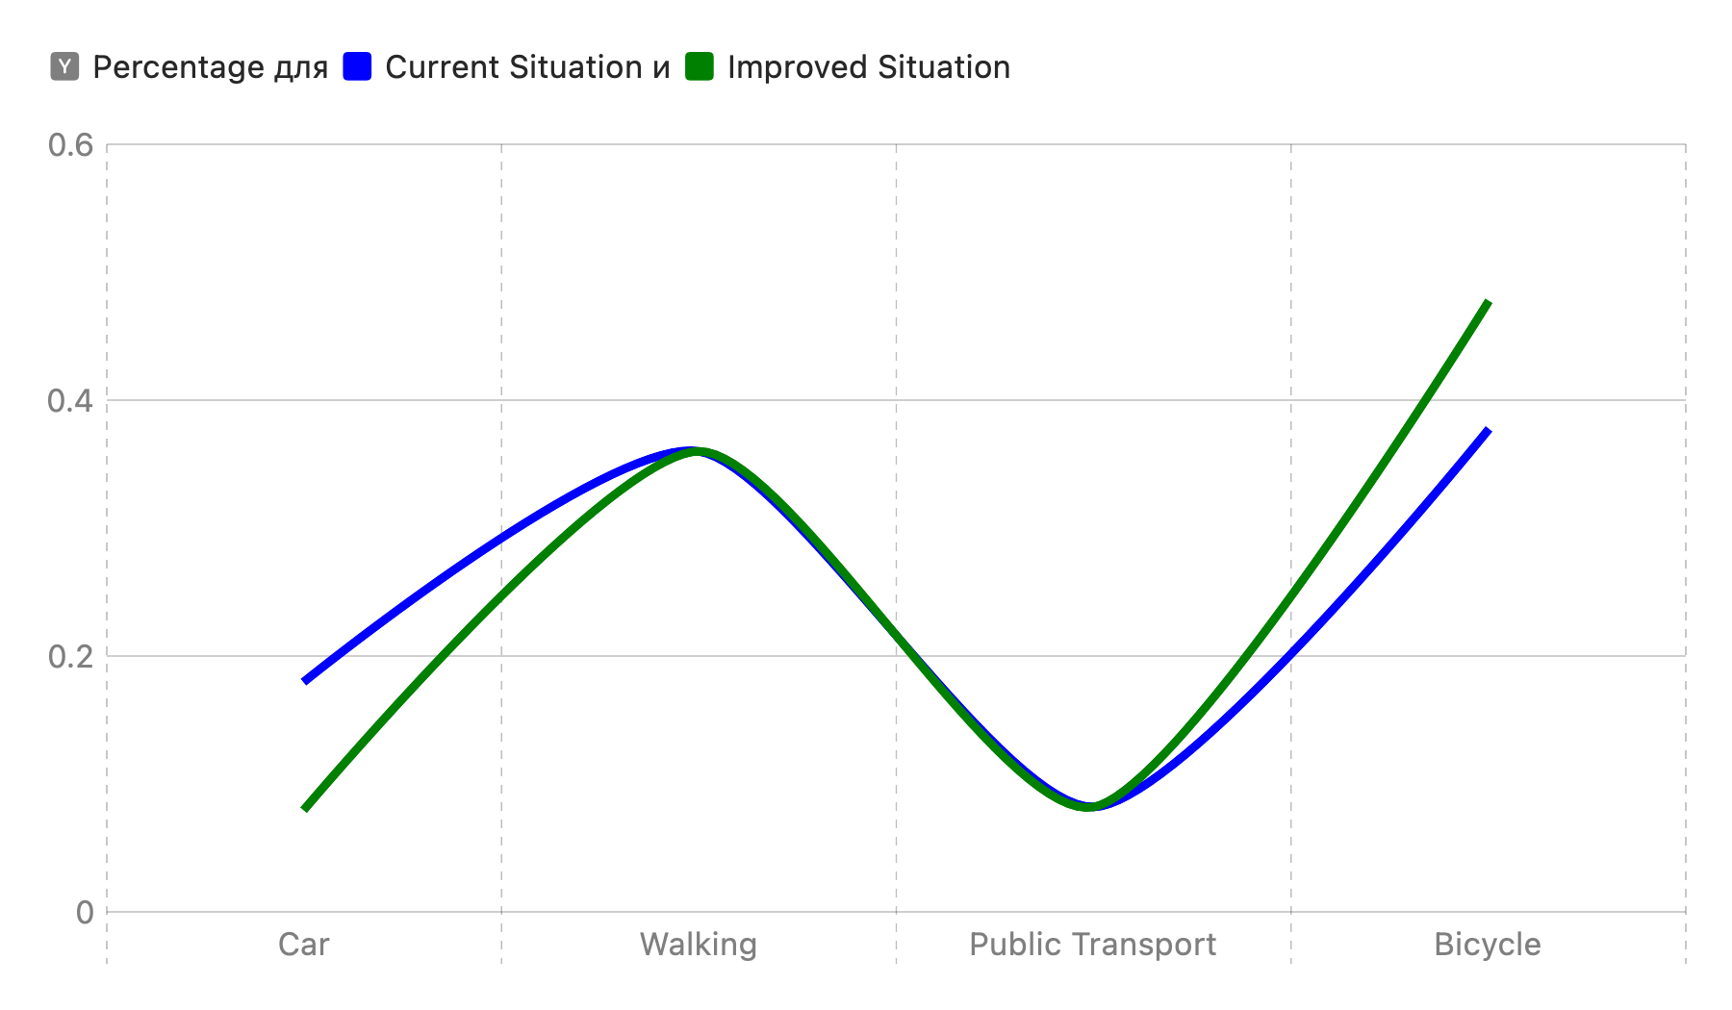
Scenarios for changes
Current Situation
Improved Situation
Percentage
Notes:
Conclusions and Assumptions
**Antalya:**
- **Conclusions:** The main pollutant is carbon monoxide (CO). Traffic jams increase travel time and energy consumption, negatively affecting finances and the environment.
- **Assumptions:** Improving public transport and reducing car use could decrease travel time and pollution.
**Hamburg:**
- **Conclusions:** Hamburg also has traffic jam problems, leading to increased travel time and energy consumption.
- **Assumptions:** Promoting bicycle use and improving public transport could reduce traffic jams and improve environmental conditions.
**Mode of Transportation Proportions:**
- **Conclusions:** Antalya has a high use of public transport, Zagreb uses cars more, and Hamburg has a well-developed bicycle infrastructure.
- **Assumptions:** Promoting bicycles and public transport could reduce car use, improve environmental conditions, and reduce traffic jams.
The chart shows two possible situations for how people travel:
• Blue line: This shows the current situation where the use of cars, walking, public transport, and bicycles stays the same.
• Green line: This shows an improved situation where more people ride bicycles (+10%) and fewer people use cars (-10%). It also suggests that there will be 20% less traffic congestion.
In short, if more people start using bicycles, it can reduce the number of cars on the road, which can make travel better, reduce traffic jams, and be better for the environment.

